Slide 1


IT FAIRE:
SGCalerías
Sistema de Gestión de Comunidades

Slide 2




Who We Are
We are two developers working to make condominium management easier with technology. SGCalerias is part of our thesis project and helps administrators and residents manage tasks more efficiently

Slide 3



Project Context
To develop an accessible product on all devices
The SGCalerias project addresses the challenges faced by condominium administrators in managing payments, shared expenses, agreements, and purchases. Many of these processes are still handled manually, leading to errors, lack of transparency, and communication issues.
Our application seeks to centralize all these tasks in an efficient digital platform, promoting organization, transparency, and ease of use for both administrators and residents.

Slide 4


Objective
To create an efficient and user-friendly platform that simplifies condominium management and fosters better communication between administrators and residents
For Administrators:
For Residents:
Simplify the management of shared expenses, allocated based on the square footage of each unit.
Enable the creation and approval of installment payment agreements.
Provide tools to manage product catalogs and sales.
Maintain a detailed transaction history and generate financial reports.
Offer easy access to pay their fees and shared expenses.
Provide flexibility through installment payment plans.
Allow the purchase of products directly from the app, with secure payment options.
Ensure financial transparency with detailed transaction histories and reports.
For those who want to simplify condominium management and enhance transparency in daily operations.
For those who need flexible payment options and easy access to condominium services

Slide 5
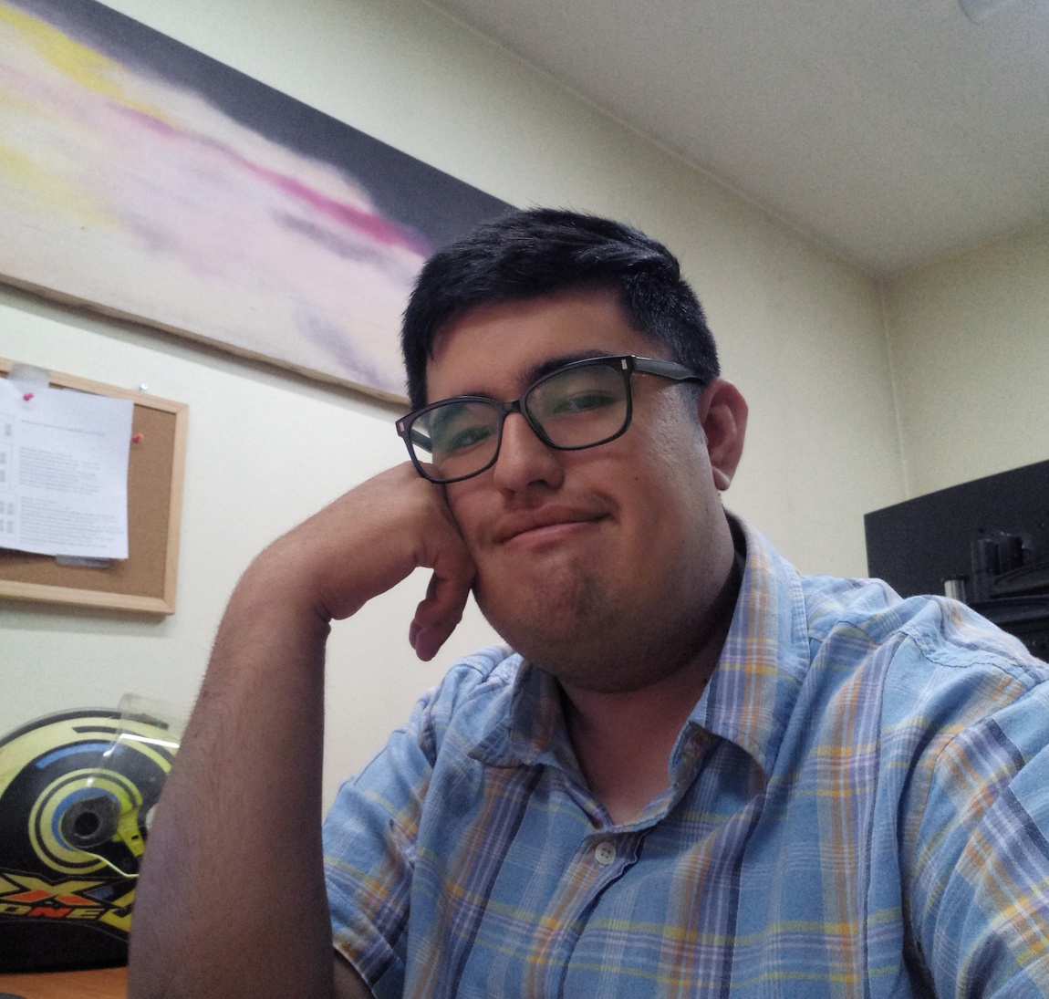


Meet Our Team
Víctor Bustos
Víctor Otero
Juan Gana
Developer
Developer
Scrum Master

Slide 6

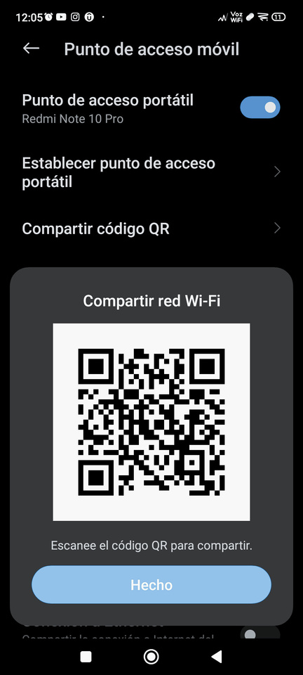






Step 1:
Connect to our Wi-Fi
How to connect to our app?
Step 2:
Scan the QR code to enter
Step 3:
Start exploring!
4051 8842 3993 7763
11.111.111-1
123
Don't hesitate to ask if you have any questions.

